Slide 1
Chapter 2: Sound and Audio
Course: Multimedia Systems

Slide 2
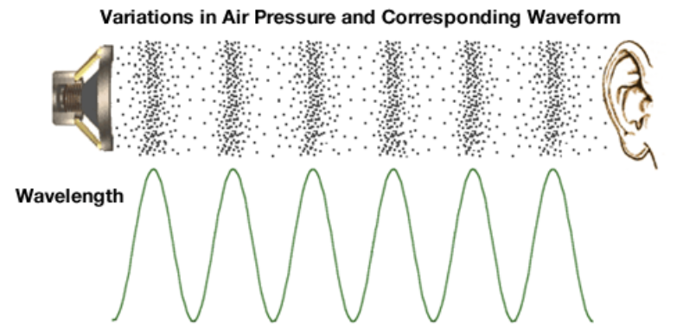
SOund
Physical phenomemon produced by the vibration of matter. E.g. String, Instruments
Sound is a form of energy that travels through mediums like air, water and solilds as vibration of waves but not in Vaccum
As the matter vibrates, pressure variation occurs that triggers in the surrounding.
This alteration of high and low pressure is propagated through different meduims and the sound is heard.

Slide 3
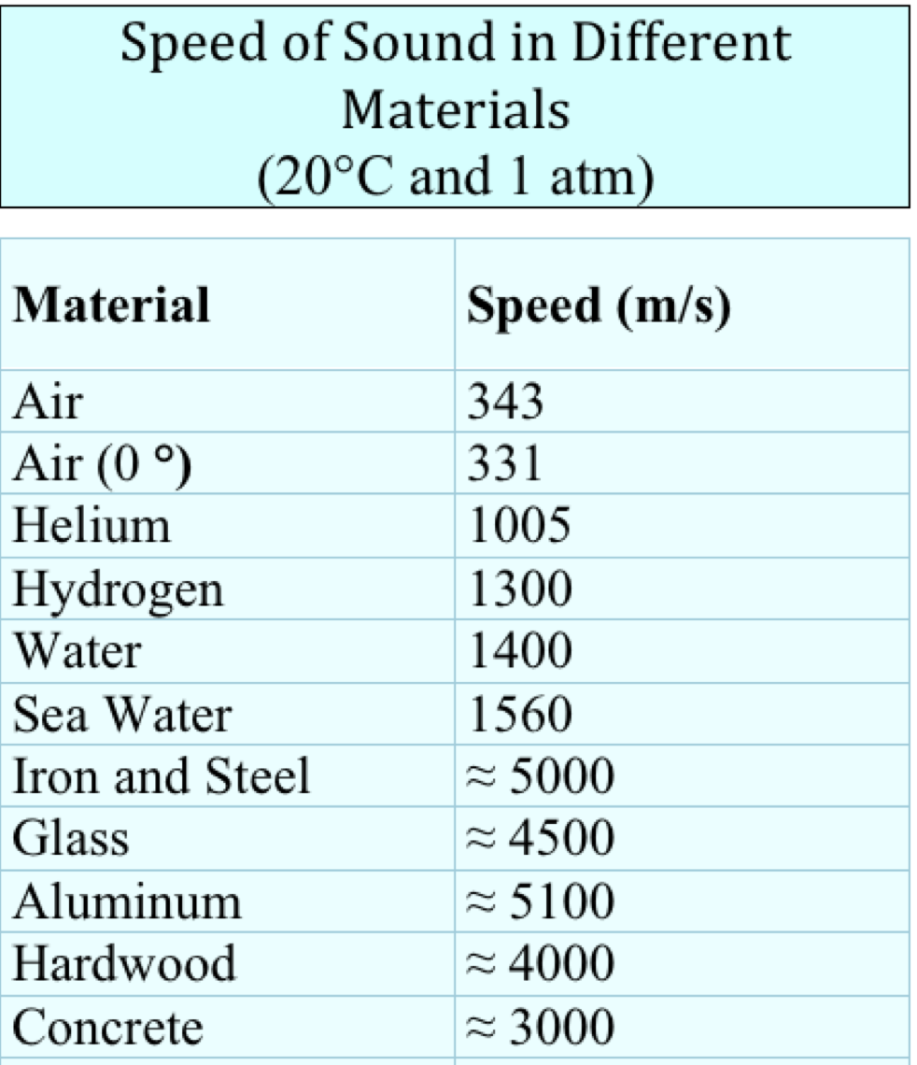
Sound..contd
The speed of sound depends upon which medium it travels.
The mediums are Solid, Liquid and Gas(Air)
Sound waves travel faster in those mediums where there are closely packed molecules.

Slide 4
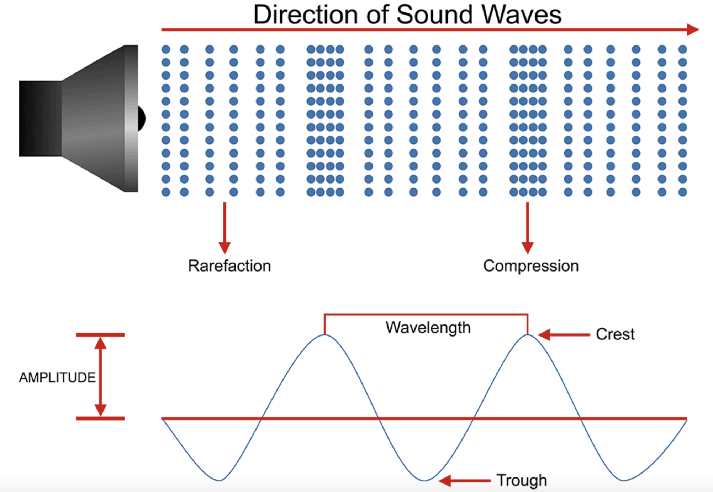
Characteristics of sound
Loudness: related to the intensity of sound waves (as the volume increases the amplitude of the waves increases)
Pitch: Related to the frequency of the waves
Audiable range : audiable to human(20 Hz – 20000Hz)
UltraSound: High pitch sound(above 20 KHz)
InfraSound: Very low pitch sound (Below 20 Hz)

Slide 5
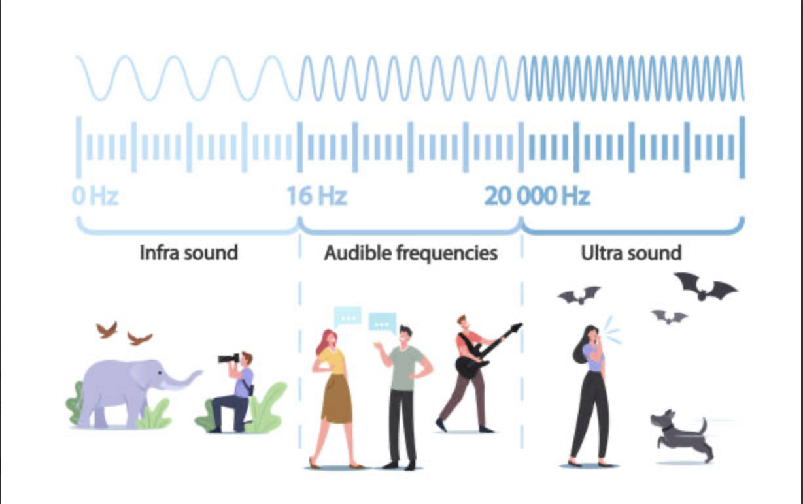
Contd..
Frequency: Reciprocal of time period(f=1/t)
Measered in Hz (Hertz): cycles per period
1KHz= 1000 Hz
Periodic waveform: repeats after certain interval, easier to predict E.g. sinewave, squarewave
Non-Periodic waveform: random sound, Harder to predict. E.g. noise, slushing of water

Slide 6
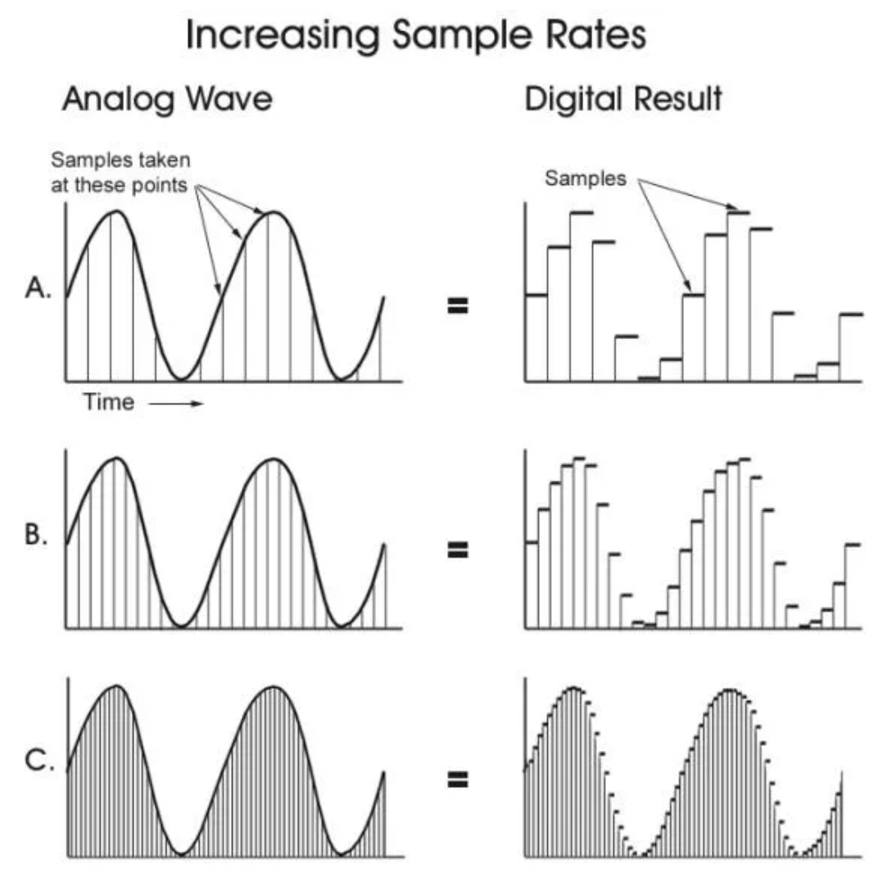
Computer representation of sound
Computer measures the amplitude of the waveform at regular time intervals to produce a series of numbers. These are called Samples.
Sampling Rate: The rate at which continious waveform is sampled is called sampling rate.
For standard CD Quality Audio(Uncompressed) sampling rate is 44100Hz (44.1KHz)

Slide 7
Nyguist Sampling Theorm
“ For Lossless digitization, the sampling rate should be at least twice of the maximum frequency of the waveform”
Sampling theorem refers to the process of converting an analog signal into a sequence of uniformly spaced numbers, allowing the original signal to be accurately reconstructed from its samples taken at a specific rate
Sampling theorem states that “continues form of a time-variant signal can be represented in the discrete form of a signal with help of samples and the sampled (discrete) signal can be recovered to original form when the sampling signal frequency Fs having the greater frequency value than or equal to the input signal frequency Fm. i.e. : Fs ≥ 2Fm
When sampling frequency equals twice the input signal frequency is known as “Nyquist rate”.

Slide 8
Sampling and Quantization
Sampling
Quantization
Provides Resolution in X- axis or Time axis
Its like taking the snapshot of the audio waveform.
More number of samples, more accurate the analog signal
Standard CD-quality audio is sampled at 44.1 kHz . That is 44100 samples per second.
48kHz is standard for audio-video
Provides Resolution in Y- axis or Amplitude Axis
Set at bit-depths
The resolution or quantization of a sample value depends upon the number of bits used in measuring the height of the amplitude and rounding them off to the nearest values.
i.e. 8 bit, 16bit (CD-Quality), 24-bit (Blue Ray). Therefore n-bits = 2^{n} possible values
Lower the quantization= lower the quality of sound
Higher the quantization= more dymanic range of the sound

Slide 9
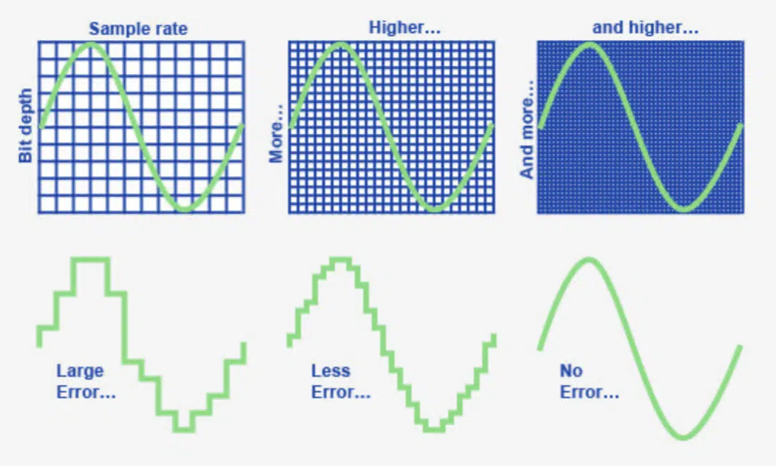
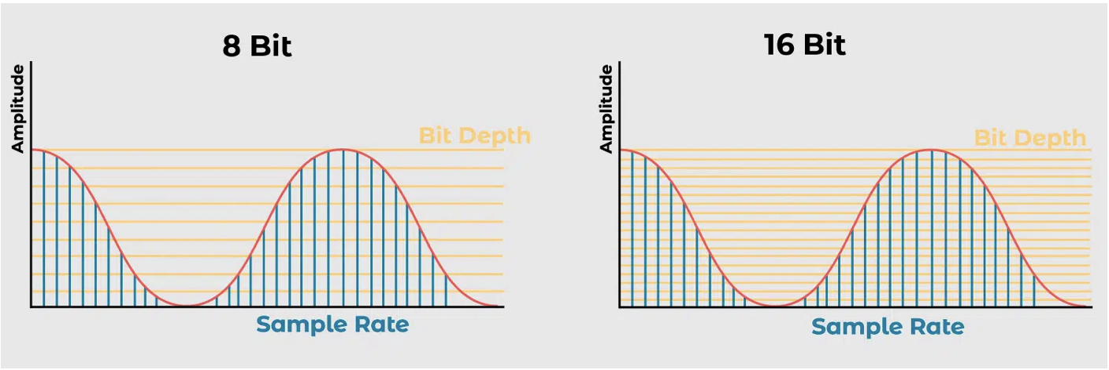
Sampling and Quantization
Sampling
Quantization

Slide 10
Can you hear the difference at higher sampling rates and bit depths?
This is a very controversial topic in the audio world - the fact is that the human ear can only hear up to 20 kHz anyway, and 44.1 kHz is perfectly adequate.
In some cases, higher sample rates can be advantageous in audio processing, but in the finished mix there is no audible difference to 44.1 kHz.
In the past, with 16-bit recorders, you always had to be careful to record as loud as possible so that the background noise was not audible
24-bit is very convenient for recording because you don't have to worry about levels. The dynamic range is so wide and the noise floor is very low

Slide 11
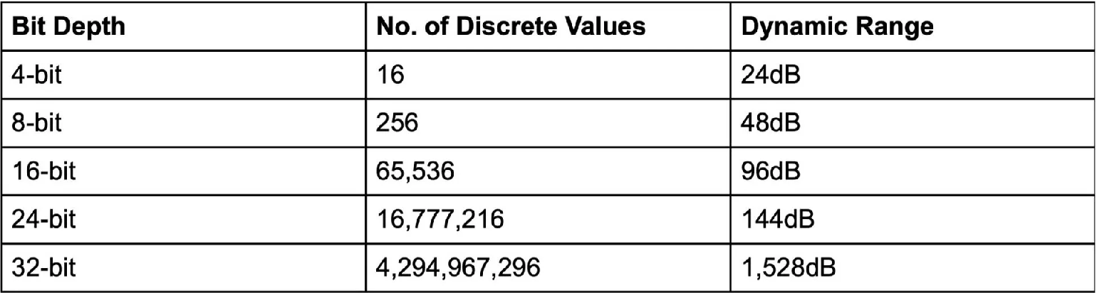
Bit depth and dynamic range

Slide 12
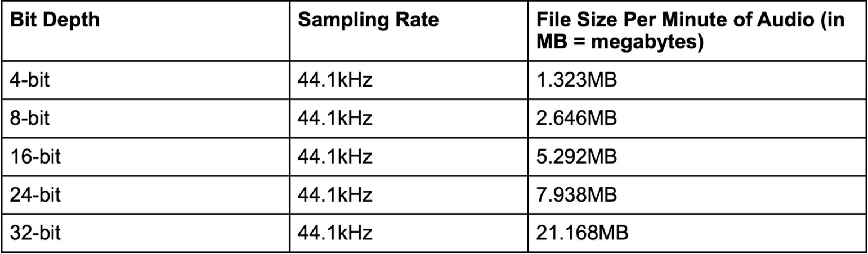
Bit Depth and File Size

Slide 13
Audio file size
Calcualte the file size for CD-quality Audio(Stereo) with the play-back time of 5 minutes.
For say a 5 min track first we convert time to seconds = 300sec.
For CD- Quality Audio Sampling Rate = 44.1 KHz = 44100 Hz
Bit Depth = 16, No. of channel = 2 (For Stereo)
Formula = (Sample rate x Bit-depth x Time) x No. of Channel
i.e. 44, 100 x 16 x 300) x 2 = (423, 360, 000) x 2 = 423,360,000 bits

Slide 14
Audio File Size
To convert to Bytes, we divide by 8 because a Byte contains 8bits.
i.e. 423,360,000/8 = 52,920,000 bytes.
Converting to Kilobytes by dividing by 1024 (the number of Bytes in a Kilobyte), then dividing by 1024 again (the number of Kilobytes in a Megabyte).
i.e. 52,920,000/ (1024 x 1024) =52,920,000 / 1,048,576 = 50.468 MB
Question: Calculate the File size(in Megabyte) of an 10 second audio sampled at 48 KHz having bit depth 24 with Mono channel.

Slide 15
MIDI
Musical Instrument Digital Interface
Relationship between Music and computers has become more interconnected considering the development of MIDI
It is a small piece of equipment that plugs directly into the computer’s serial port and allows the transmission of signals
Now it has become a standard for every manufacturers of electronic musical instruments
It has a set of specifications so that instruments of different manufacturers can, without difficulty, communicate musical information between one another

Slide 16
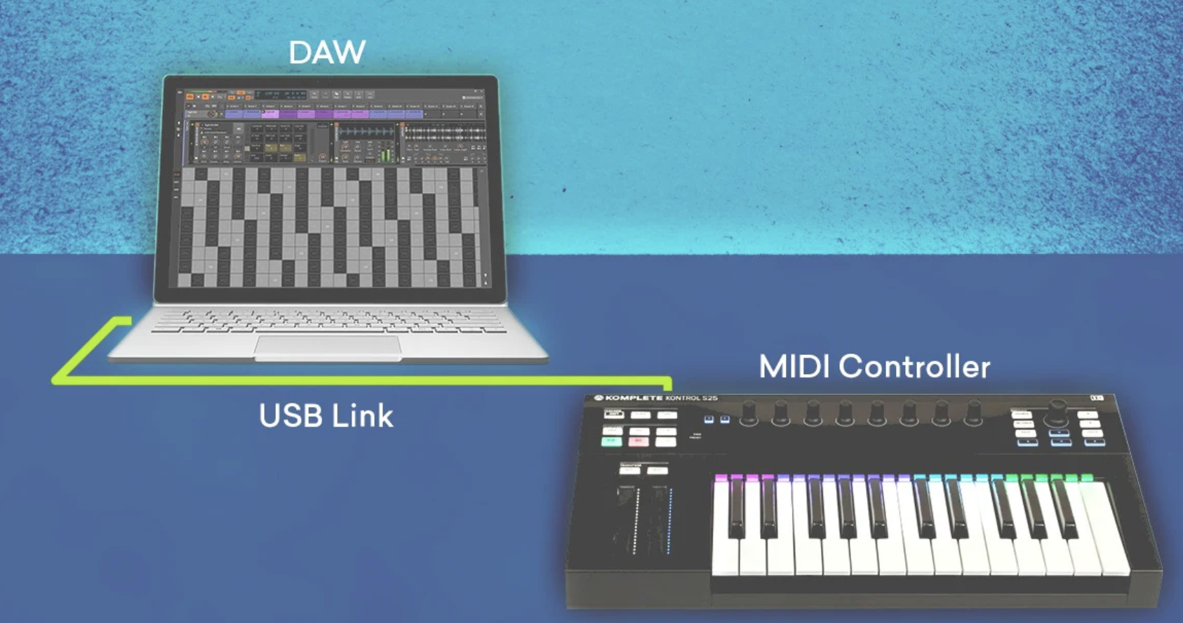
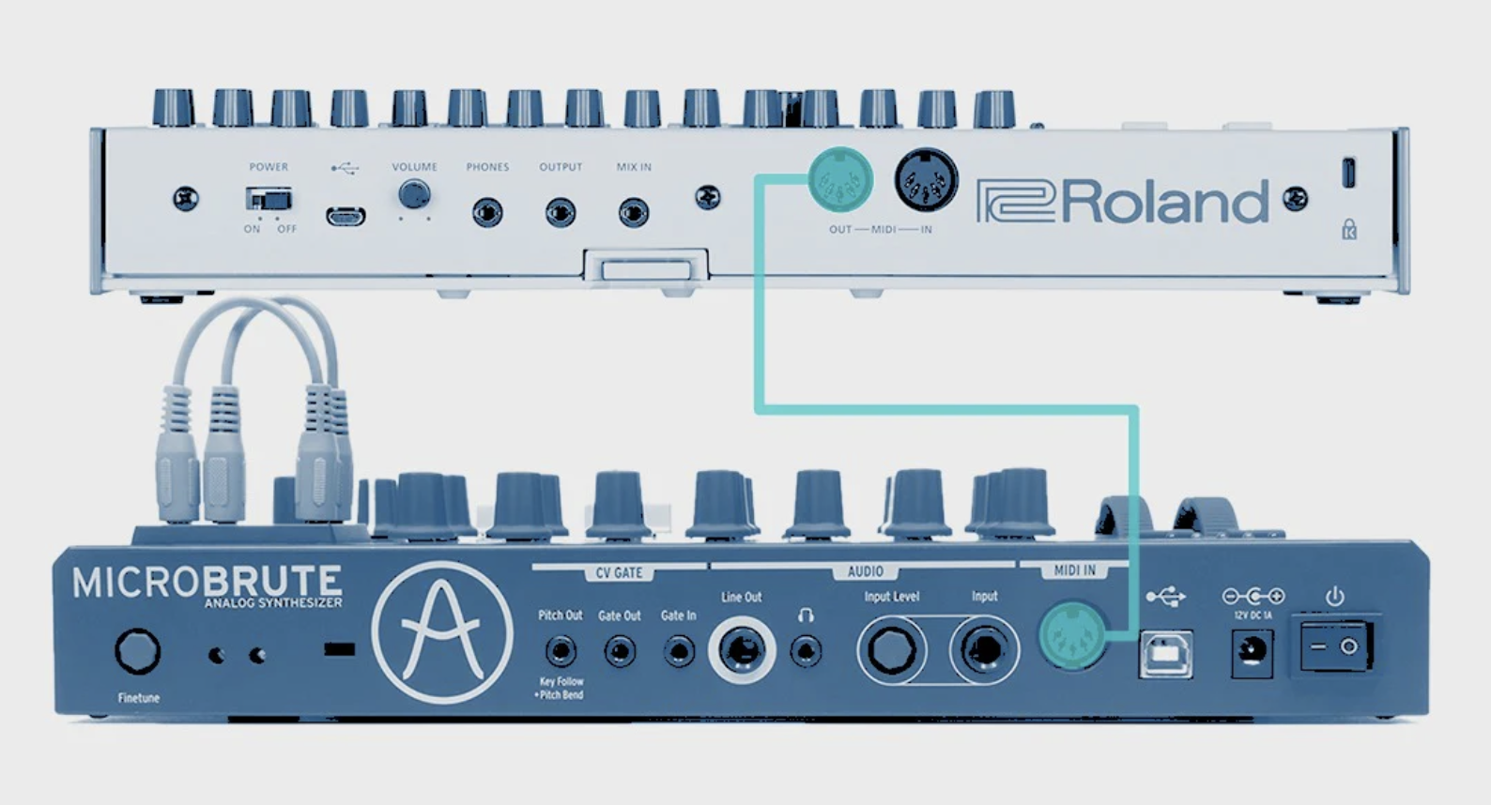
MIDI

Slide 17
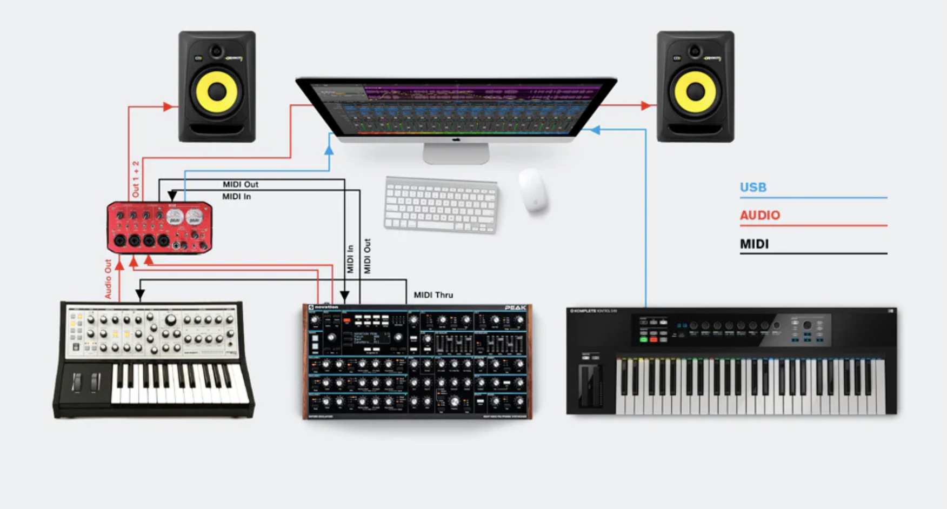
Midi

Slide 18
How does it work?
A musical instrument takes an input MIDI input signal, which can be as simple as an audio signal, and produces a MIDI output signal.
MIDI-capable devices can send/receive data in several ways
A MIDI compatible instrument like the Roland FT-817 produces a MIDI note and plays it on its own devices or can copy it and play it on another instrument.
The notes are produced when a key is pressed, or a gate button is pushed, sending the resulting electrical signal to an amplifier to generate a pitch that is the audio amplitude of the note.
MIDI also has considerable digital and analogue manipulation capabilities for the creation of and modification of sounds

Slide 19
What does Midi do?
It is basically a score that is read by a compatible music synthesizer.
If you play a note on your keyboard, the MIDI converts it into numbers and sends it to the software or hardware that will then make that sound.
If you change the score, the sound changes.
MIDI does not send the sound wave made by an instrument; instead, it sends information about the music notes, and the receiving device uses its own internal mechanisms to generate the sounds.
Many video games use MIDI files for music rather than recorded music because the size of the files is so small.
This is a popular way for amateur and independent musicians to distribute their music. It cuts out the record company and makes it easier for people to get the music to the audience.

Slide 20
Components of MIDI interface A MIDI interface has two components
Hardware:
Consits of different physical hardware devies to built the system
Specifies the physical connection between musical instruments using MIDI cables
2. Data Format:
The information that travels through the hardware devices
The encoding includes the notion of the beginning and end of the note, frequency and volume information
Also includes information such as stroke intensity(hammering effect)

Slide 21
MIDI modes
To tune a MIDI device to one or more channels, the device must be set to one of the 4 reception modes
Mode 1: Omni ON/ Poly
Mode 2: Omni ON/ Mono
Mode 3: Omni OFF/Poly
Mode 4: Omni OFF/ Mono
If Omni is turned ON, the MIDI device monitors all the MIDI channels and responds to all channels.
If Omni is turned OFF, the MIDI device responds only to the channel messages sent on channel the device is set to receive.
If Poly is set, the device can play several notes at a time.
If Mono is set, the device plays one note at a time.

Slide 22
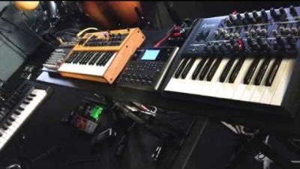
https://youtu.be/FHmshRb5HQs?si=lZr2s6Y91rQ3F-7b

Slide 23
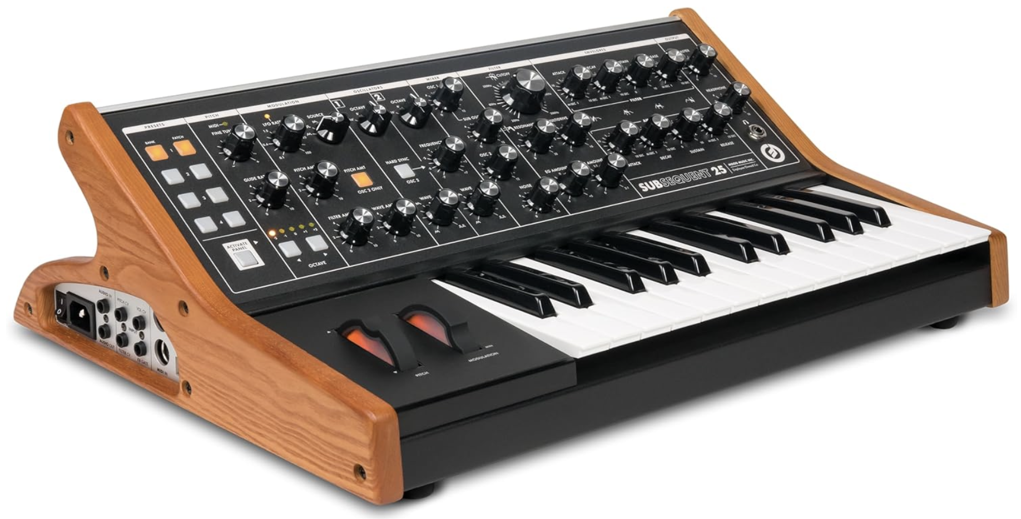
MIDI Devices
The heart of any MIDI system is the MIDI Synthesizer device.
A typical synthesizer looks like a simple keyboard with a pannel full of buttons.
Most synthesizers have the components as:
Sound Generators
Microprocessor
Keyboard
Control Pannel
Auxillary Controllers
Memory

Slide 24
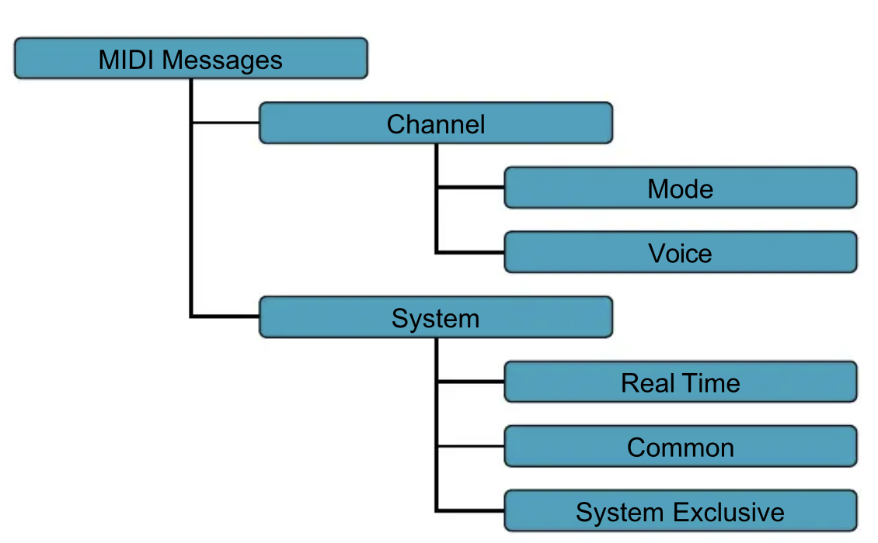
MIDI Message
MIDI message transmit the info. Between MIDI devices.(8-bits)
Every MIDI message would consist of the status byte( First Byte-1)
i.e. 1XXXXXXX
It describes the kind of message and the following bytes would contain the data bytes. ( First Byte-0)
i.e. 0XXXXXXX

Slide 25
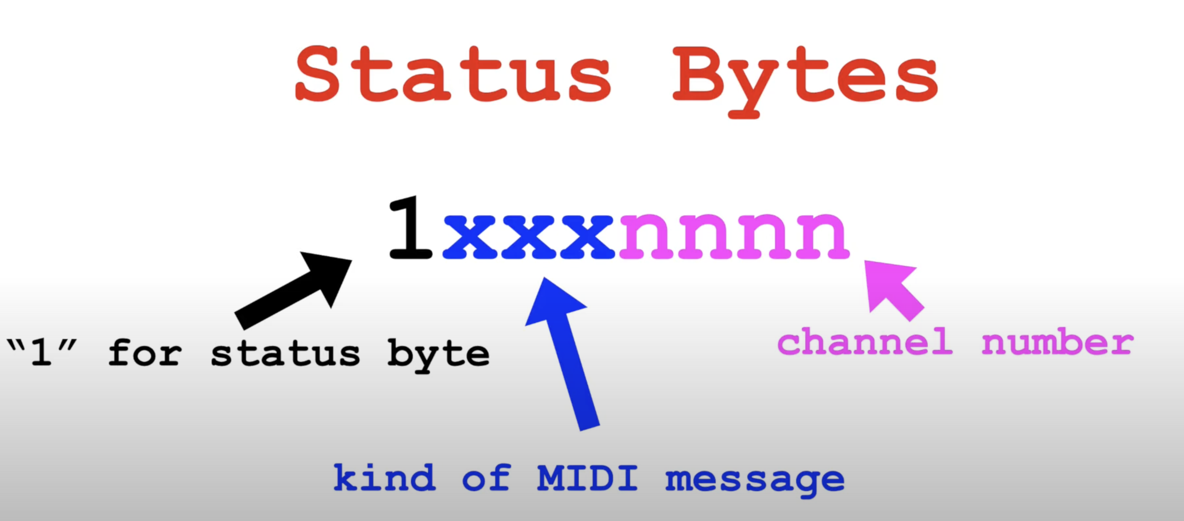
Format

Slide 26
MIDI Messages
1. Channel Messages
Go to only specific device
Two types :
1. Channel Voice Message: It sends the actual performance data between MIDI devices that describes keyboard action, controller action and control pannel changes.
Defines pitch, amplitude, timbre, duration, note ON, note OFF, pressure
2. Channel Mode Message: Determines the way the receiving MIDI device responds to the channel voice message
Eg. Omni OFF, Omni ON
2. System Messages
Go to all devices in MIDI system.
i.e. 1111XXXX
Three Types:
1. System Real Time Message: Very Short 1 byte message that is used to synchronize the timing of devices (Clock)
2. System Commom Message: They are commands that prepare the synthesizers to play a song. Song Select, Tune Select
3. System Exclusive Message: They are the message that depend upon different types of instuements. Yamaha, Roland etc

Slide 27
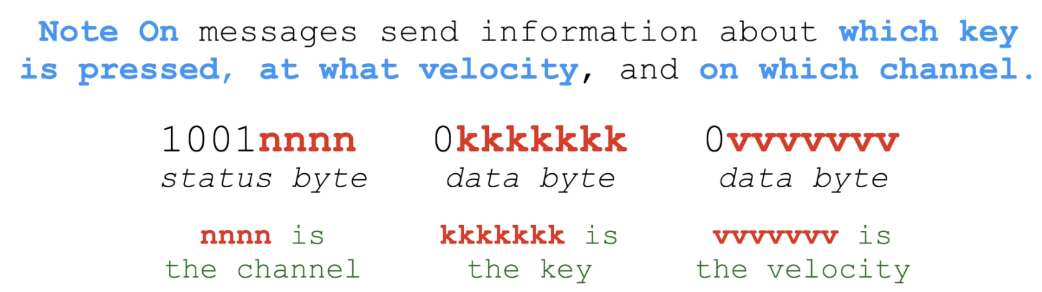
MIDI Channel MEssage

Slide 28
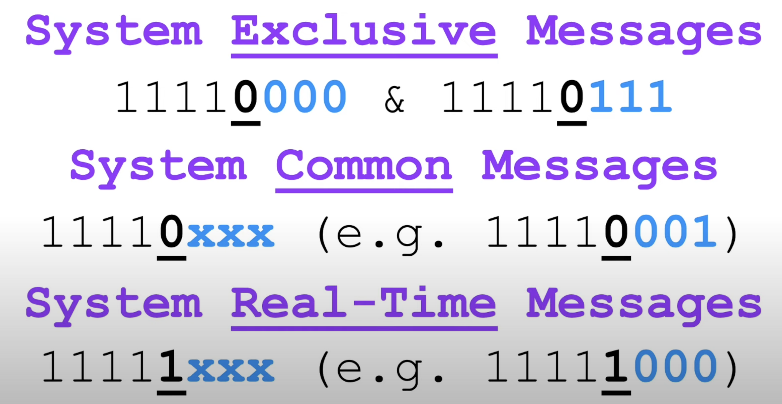
MIDI System Message

Slide 29
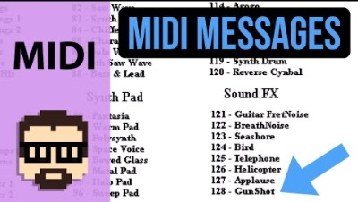
MIDI Messages_Video

Slide 30
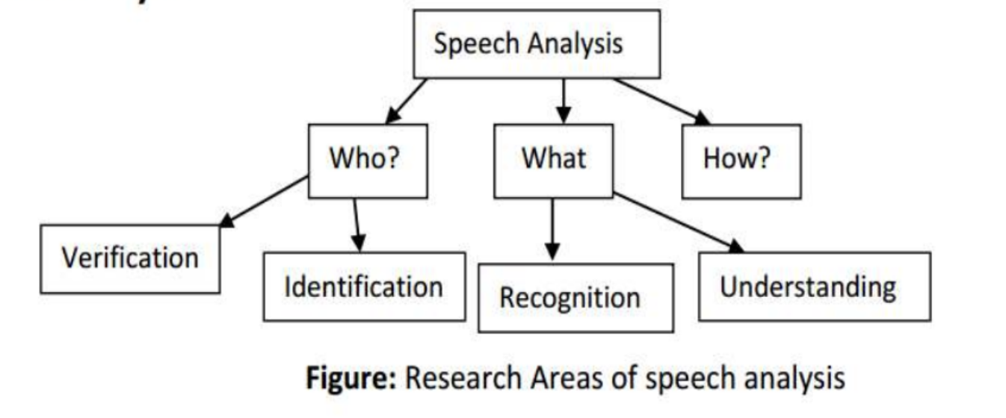
Speech Analysis

Slide 31
Speech Analysis
Human Speech has certain characteristics determined by the speaker.
This analysis can serve to analyze WHO is speaking i.e. recognize the speaker for his/her identificaiton as acoustic fingerprint.
Another task of analysis is to analyze WHAT has been said i.e to recognize and understand the speech signal itself.
Another area of analysis is to analyze how it has been said by the respective person. Focuses on the style of delivery and finding out whether the person said it anger or calm mood.
For these analysis, environment noise, room acoustics and speakers physical and psychological conditions plays a vital role.

Slide 32
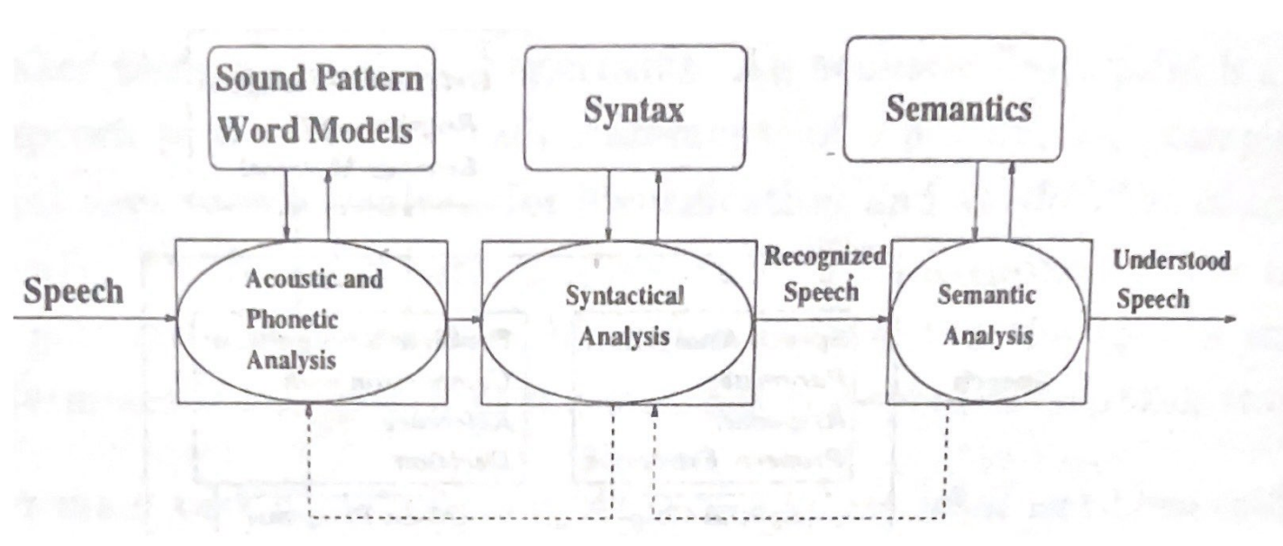
Compenents of speech recognition

Slide 33
Speech recognition
In the first step, acoustical and phonetical analysis is performed
i.e. pronounciation of words
In the second step, the speech unit is passed through a syntactical analysis(Syntax of the sentence)
i.e. correctness of the sentence
In the third step, the semantics of the preciously recognized speech if analyzed.
i.e. Meaning of the speech or sentence

Slide 34
Problems faced during speech recognition
1. Overlap due to echo of the aucostics from the wall of primary sound wave
2. Co-articulation: Very often the neighbouring words flow into one another. This would create a recognition issue or confusion.
3. Time taken by the individuals. (Speaker dependent)

Slide 35
End of chapter 2

